Slide 1
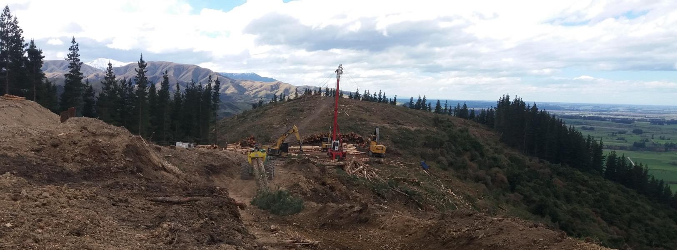

Harvesting Technology & Automation Trends
Rien Visser (& Hunter Harrill)
UC School of Forestry

Slide 2
Presentation Overview -
Autonomous forestry machines; the robots are coming!
Benchmarking; tracking cost and productivity since 2008!
Yarder survey: what has changed 2012 → 2018?
  Euro yarders for NZ: we’re going hybrid!
Improve system performance through technology…
  Tension monitoring – ‘safety in numbers’?
  Machine utilisation – who is doing what where?
  Crew training – getting our results to where it matters!
Integrated biomass harvesting: dealing with our residues!

Slide 3
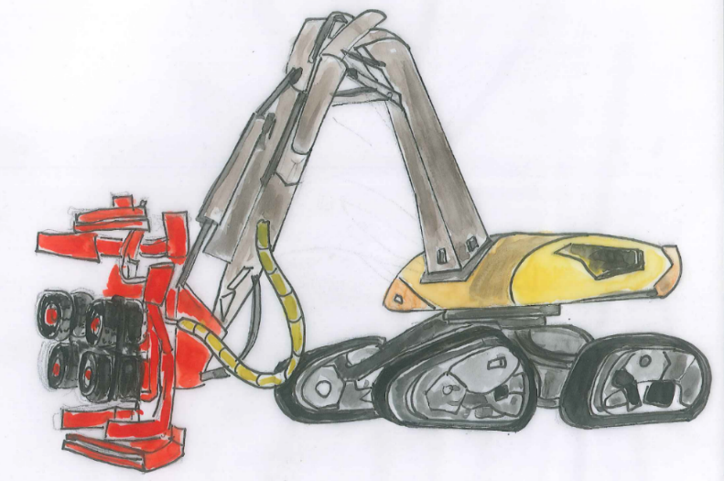
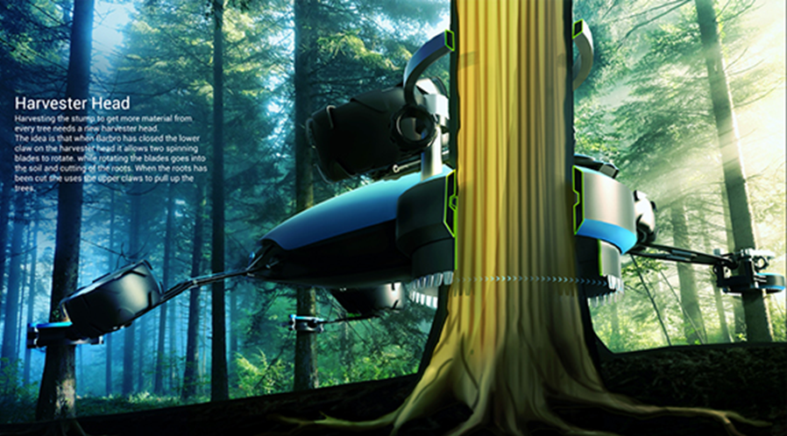
Autonomous forestry machines the forest?

Slide 4
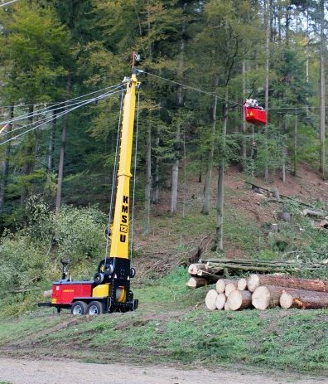
Example: Semi-autonomous yarder
Computer control / autonomous carriage movement.
→ no operator and or operator free to undertake other tasks.

Slide 5
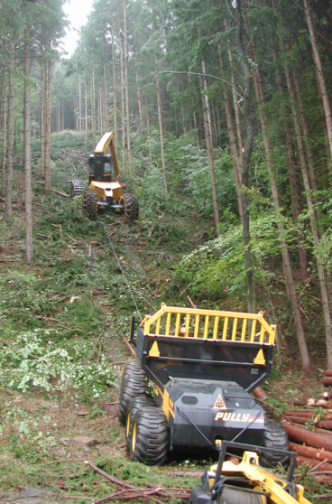
Forestry - Konrad ‘Pully’
Semi-autonomous, but guided by cable!
Designed for slope, shuttle between harvester and roadside / landing area

Slide 6
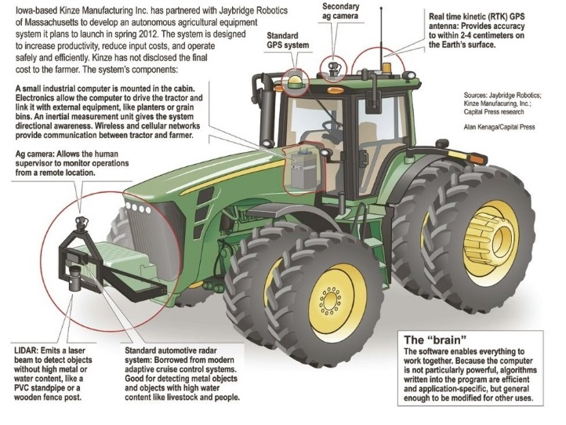
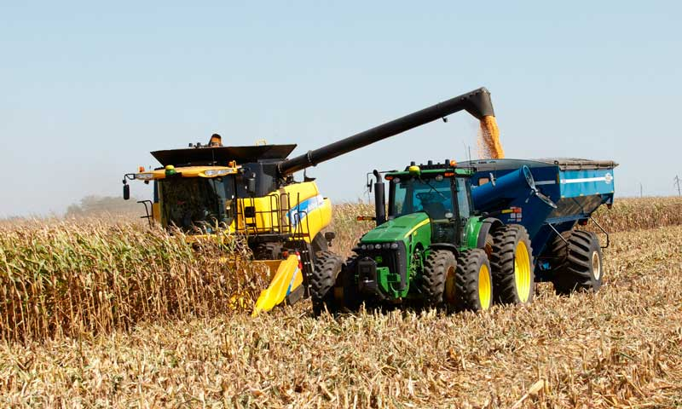
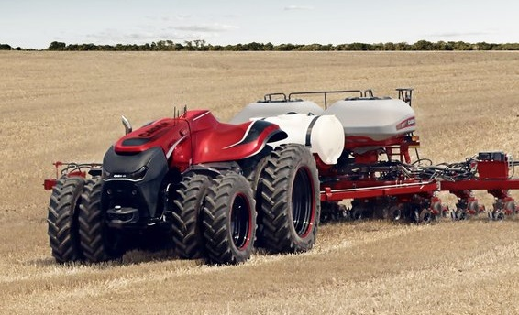
Autonomous ‘Extraction’ – how does it work?
Tractor Drone
Already advanced - for harvesting crop (e.g. grain)
Aligns with harvester using GPS + sensors
Returns to unloading area by GPS
Purpose built!

Slide 7
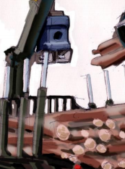
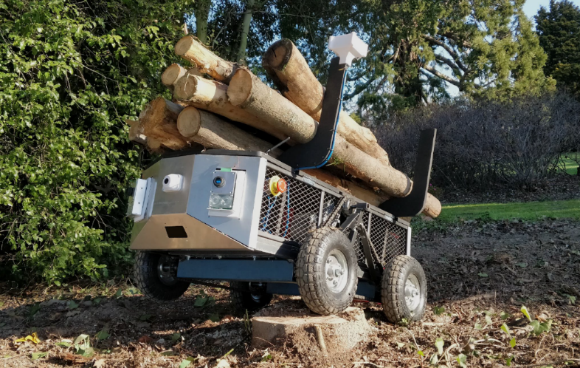
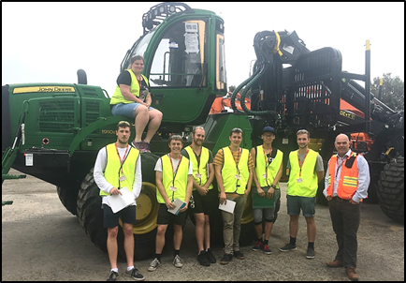
Autonomous Extraction
Most logical + largest commercial opportunity?
Forwarder/skidder, shuttle logs /stems from harvester to ‘landing’
Loading / Unloading by harvester and or designated loader(s)
Semi-autonomous - Movement + remote operator loading / unloading
Student project (FGR / FWPA)…
Autonomous forwarder +self-loading (Image from Ringdahl 2011)

Slide 8
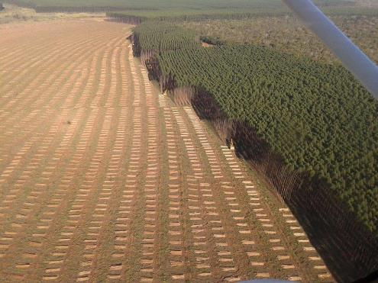
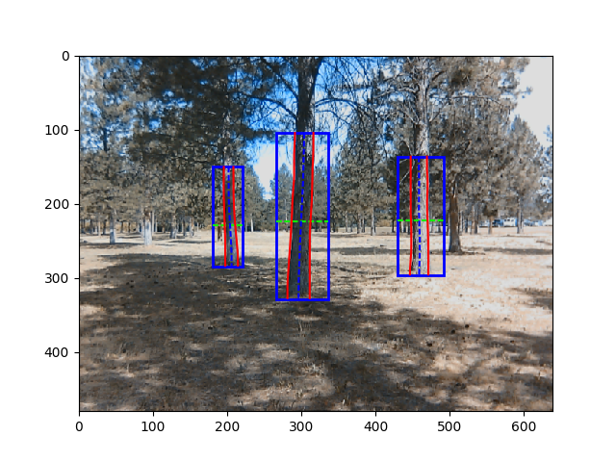
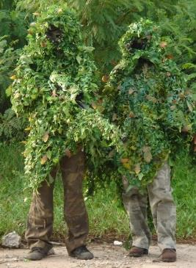

Autonomous felling? – we cant see yet!
Hardware is there – technology exists
Software is not – hard to see the trees!
Ask the Cloud!
Output from the OSU / USFS tree identification vision system: Lucas Wells & Woodam Chung

Slide 9
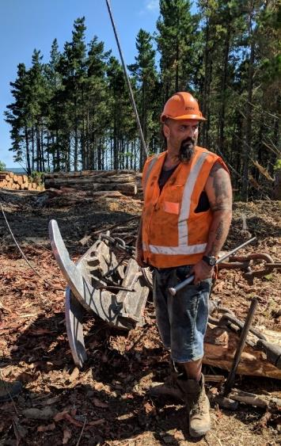
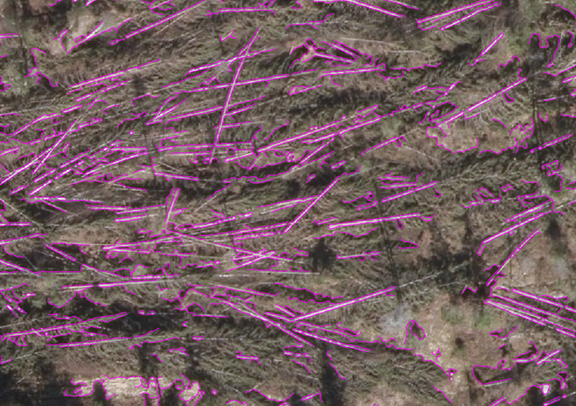
But, vision…
Software can identify defined shapes…
i.e. felled stems on a cable logging site to automate yarder movement and pick up…
Output from the NIBIO, Norway

Slide 10
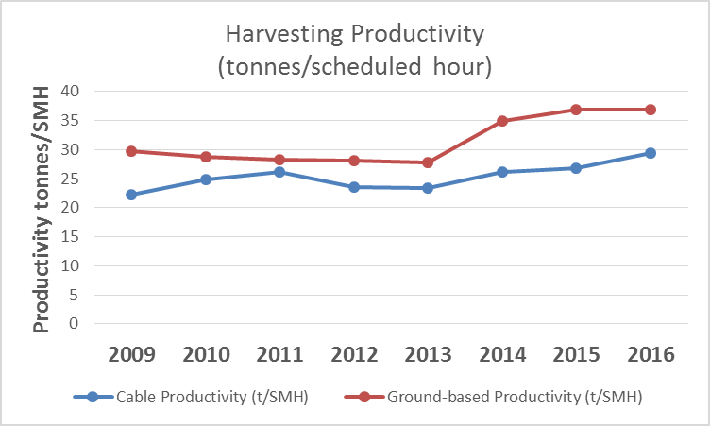
FGR UC Benchmarking System
Successful system – since 2008 – 1400+ unique entries
Tracking cost and productivity:
Based on 20 stand, terrain and
systems parameters.
2017 results?
GB = $26.80/t (range $14 to $55)
Yarder = $39.40/t (range $19 to $70)

Slide 11
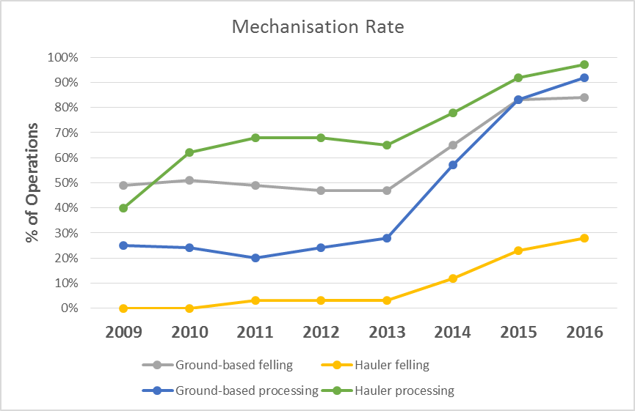
Benchmarking – Mechanisation
A significant change!! →
Worker / Machine ratio?
GB = 1.35 Yarder = 1.5
Winch assist?
$1.30/t higher: paying a small premium for this service?
but, systems operating on steeper slopes

Slide 12
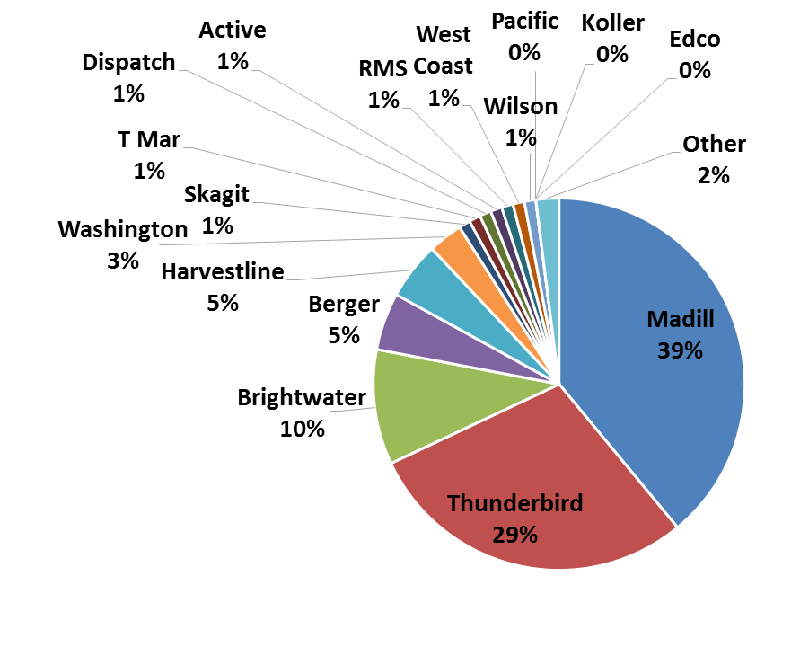
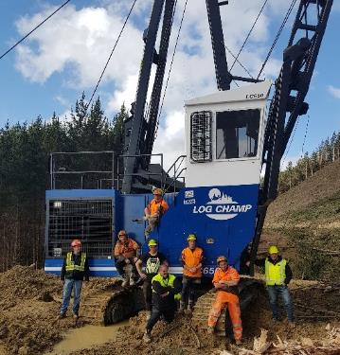
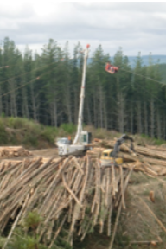
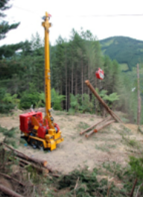
Yarder Survey – 2018 Results
343 entries (2012 = 305)
Shift towards East Coast (49→ 70!) & Southern NI (23→ 54).
Greater proportion of crews in woodlots (estimated 30%)
New players: T Mar, Active, Koller

Slide 13
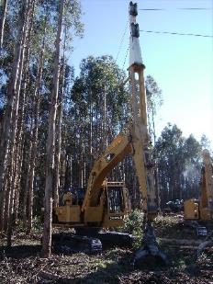
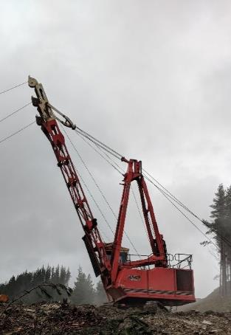
Type & Models…
More swingers
More excavators
And… no surprises? bigger!
Yarder Type | 2012 | 2018
Tower | 67% | 58%
Swing | 30% | 36%
Excavator | 3% | 6%
Yarder Model | #
TMY 70 | 31
Madill 071 | 26
Madill 123 | 18
Madill 124 | 17
Madill 171 | 17
BE70LT | 13
Madill 009 | 13
BE85 | 10
Yarder Model | #
Madill 124 | 35
Madill 071 | 26
TMY 70 | 25
BE 70 & 70LT | 23
Madill 123 | 22
Madill 171 | 15
TSY 255 | 14
Madill 122 | 12

Slide 14
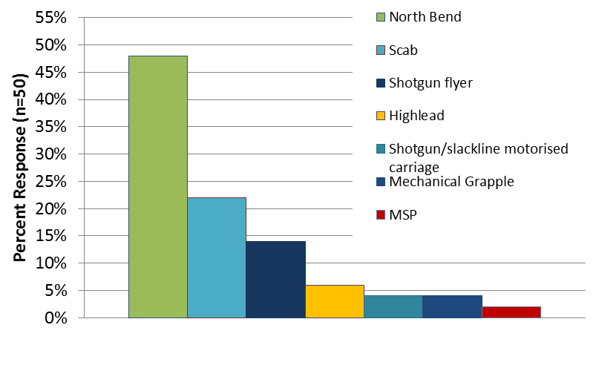
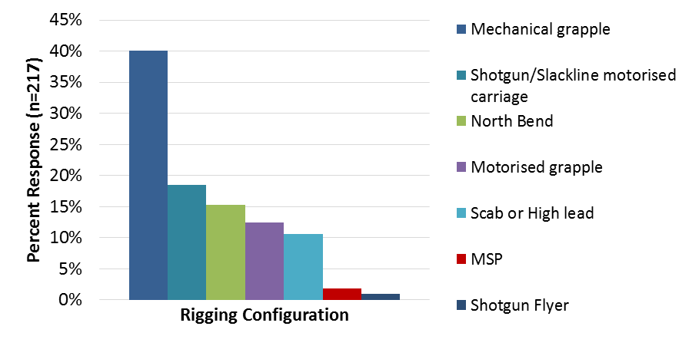
Rigging Configurations used?
We are changing!
2012 – top 4 preferred systems all ‘manual’
2018 – 3 of 4 preferred systems ‘mechanical’

Slide 15
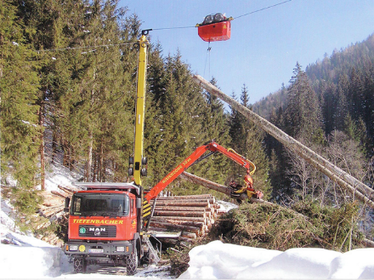
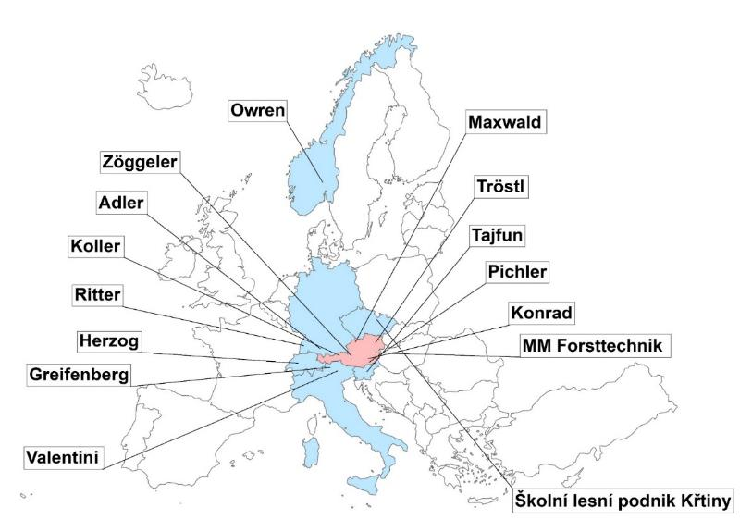
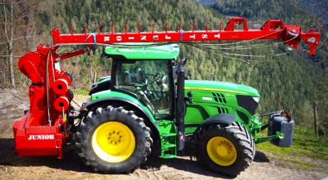
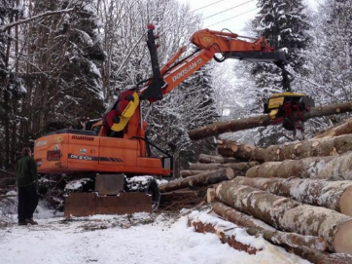
European Yarder Design Project
Goal?
EU – 15 manufacturers, 63 different models!
Best of both worlds: Euro smarts and north American strength?
UC - support design and NZ testing

Slide 16
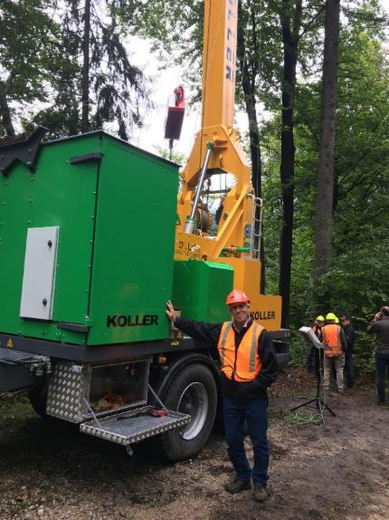

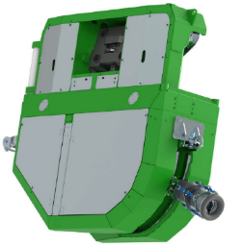
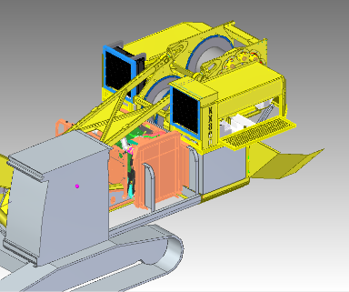
European Yarder Design Project
Contractor visit to EU 2017
Two main design options... both hybrids!

Slide 17
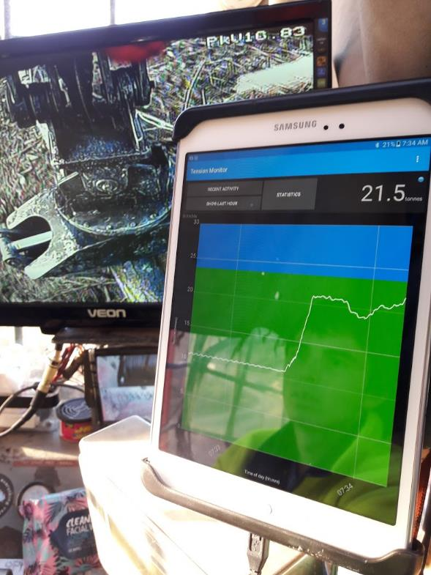
Technology: Tension Monitoring App
UC / FGR Tension monitoring research → Lots!!
Cable yarders (H. Harrill PhD)
Winch-assist testing
Info extensively used for safety design, testing and training.
2016 Student project (Amy Martin)
make an operator friendly App
now commercial through DCE!

Slide 18
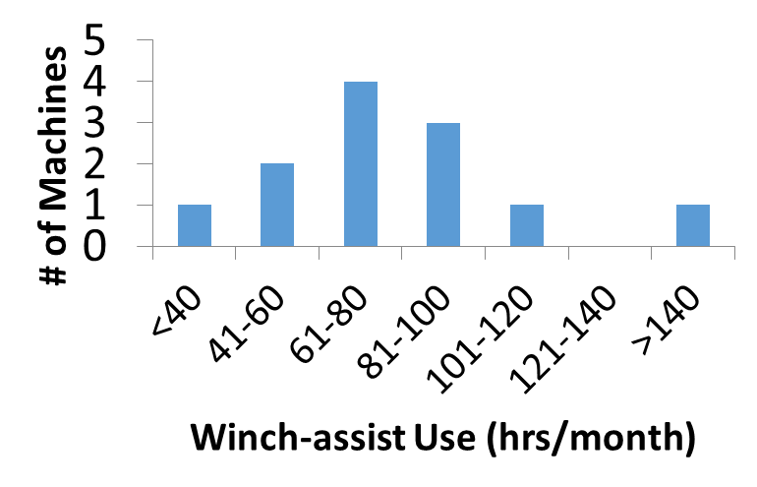
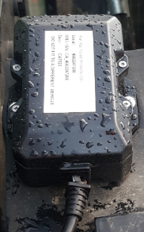
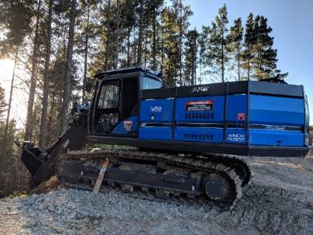
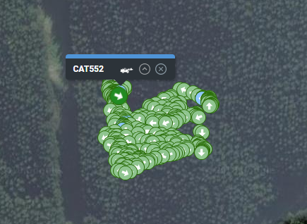
Technology: GPS Tracking
/ Utilisation Rate
Typical machine utilisation info →
For winch-assist? Avg 82 hrs/month or 45%
Student project
  Ben Reriti – Panpac → GPS tracking
  Cameron Leslie – NZ/CAN → Time study

Slide 19
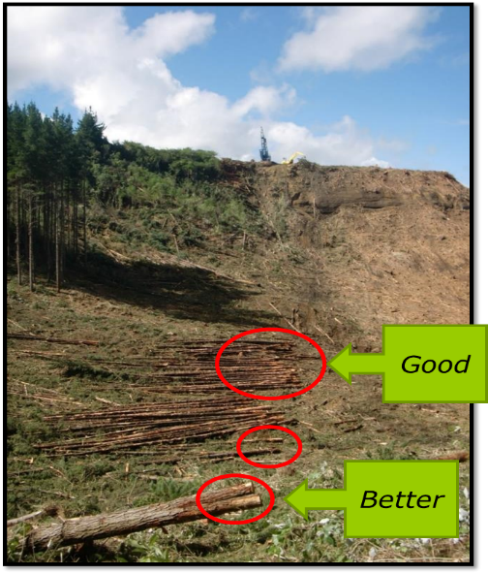
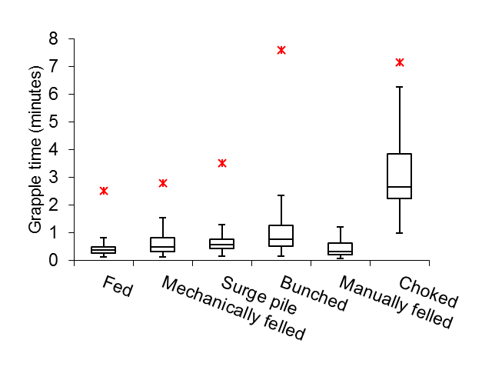
Extension / Crew Training
New challenges with full mechanisation
Convert research into training materials for loggers
  Winch-assist workshops (27 to date)
  Cable logging & guyline workshops
  Cable logging productivity coaching (supported by Rayonier & Ernslaw)

Slide 20
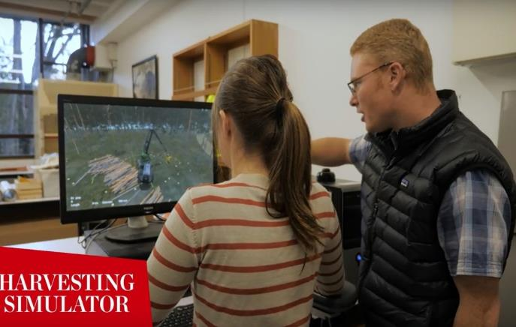
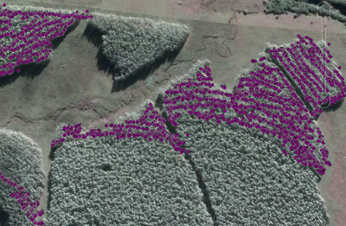
Harvester Simulator Project
Good for training, but also research…
Previous project
  comparing operators with gamers
Current FGR projects:
  comparing aptitude / personality traits
  checking simulator ‘accuracy’ – real versus simulated stand –
  prep for remote operated machinery

Slide 21
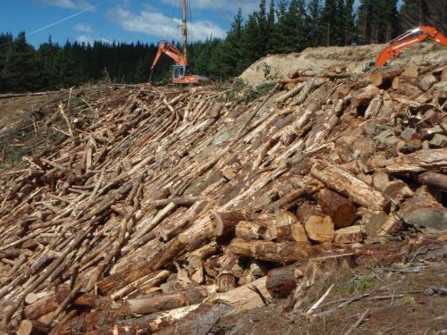
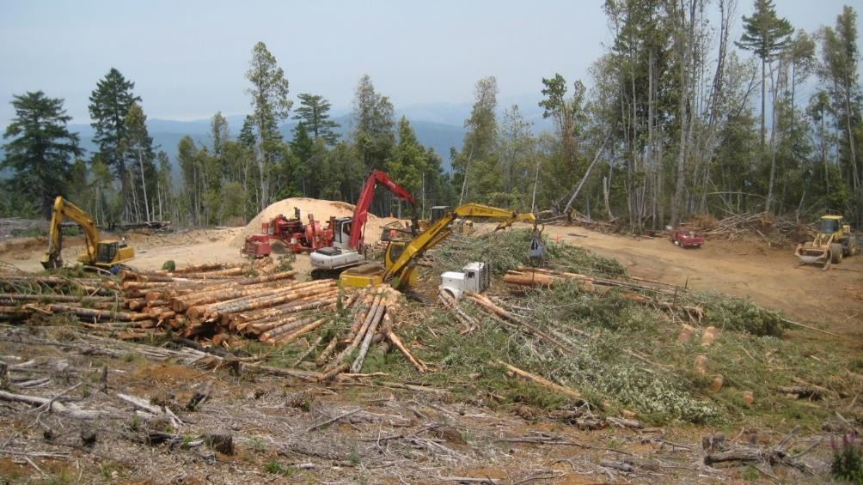
Integrated biomass systems
‘New’ FGR project – actively managing large volumes on smaller landings…
  Note: also LIRO 1990s, UC 2008, FFR 2010!
Sharing international experience
+ NZ based case studies
Systems + products + markets

Slide 22
The simple summary…
Many exciting automation opportunities in the near future: from simple technology improvement through to fully autonomous
FGR / UC ‘collaboration’ very beneficial (for both hopefully!).

Slide 23
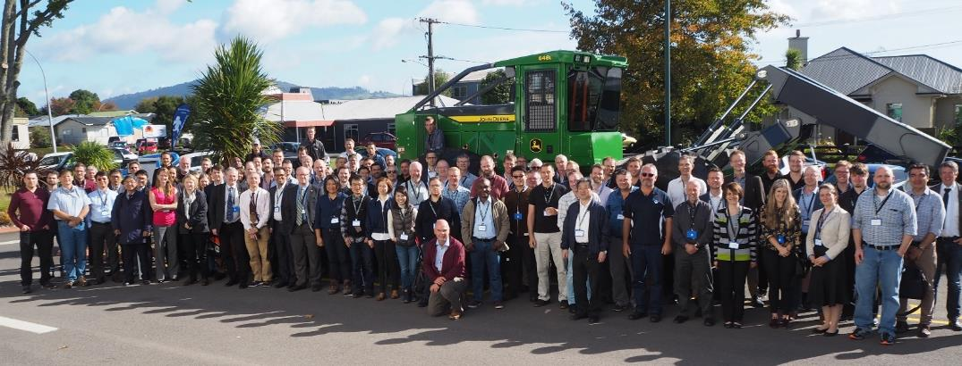
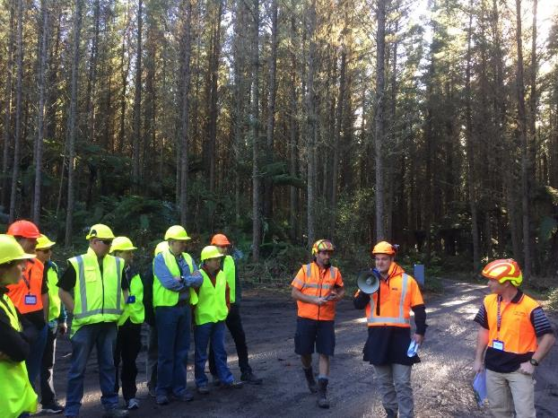
With thanks to FGR….
International FE Conference 2018
16-19 April, Holiday Inn, Rotorua
“Quenching our thirst for new knowledge.”
Conference; approx. 180 participants (60+ internationals, 22 countries) – very positive feedback! All conference presentations online.

Slide 24

Rien Visser
School of Forestry
University of Canterbury
Rien.Visser@Canterbury.ac.nz
www.fgr.nz

